Slide 1
Static Routing

Slide 2
Objectives
Define the general role a router plays in networks.
Describe the directly connected networks, different router interfaces
Examine directly connected networks in the routing table and use the CDP protocol
Describe static routes with exit interfaces
Describe summary and default route
Examine how packets get forwarded when using static routes
Identify how to manage and troubleshoot static routes

Slide 3
General Role of the Router
Functions of a Router
  Best Path Selections
  Forwarding packets to destination

Slide 4
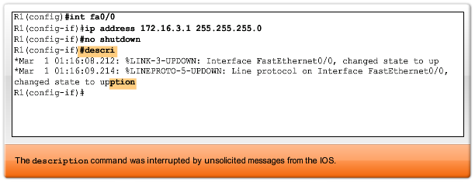
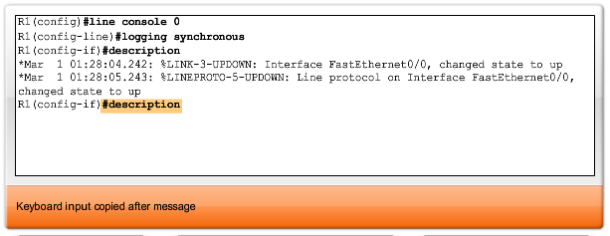
Unsolicited message from IOS

Slide 5
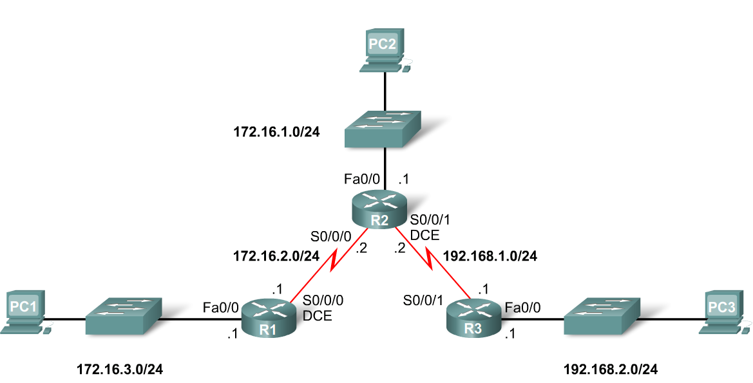
Routing Table and CDP Protocol
When a router only has its interfaces configured & no other routing protocols are configured then:
  -The routing table contains only the directly connected networks
  -Only devices on the directly connected networks are reachable

Slide 6
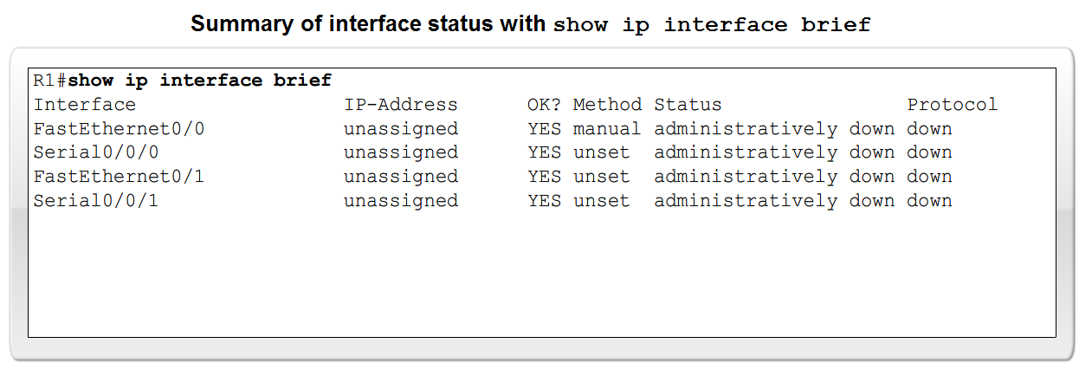
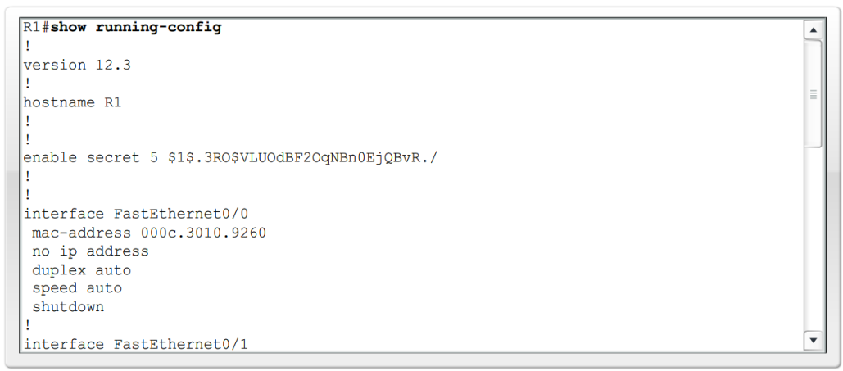
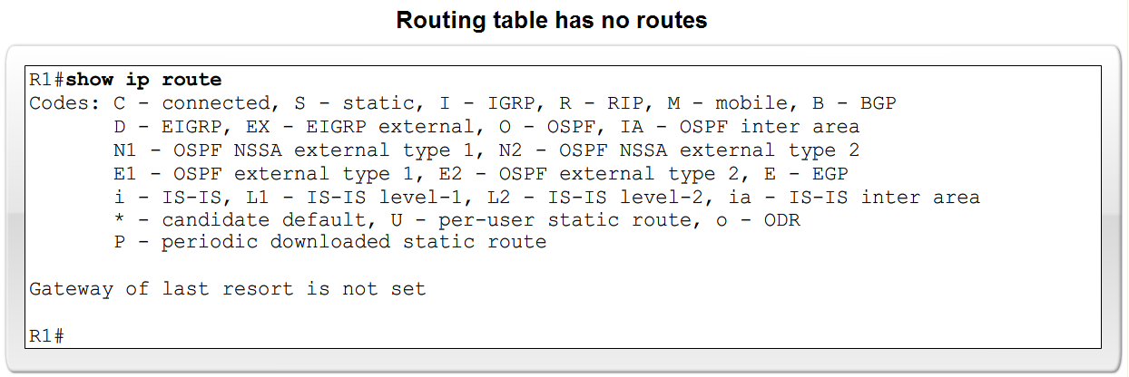
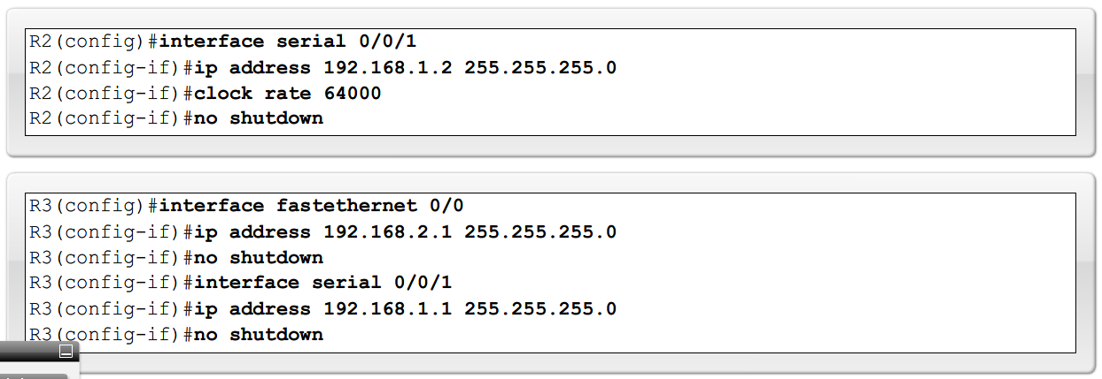
Routing Table and CDP Protocol

Slide 7
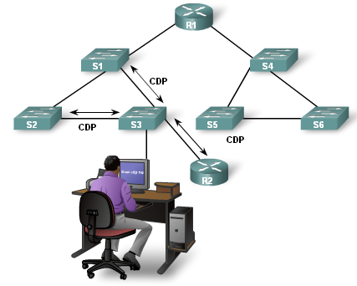
Routing Table and CDP Protocol
Purpose of CDP
  A layer 2 cisco proprietary tool used to gather information about other directly connected Cisco devices.
Concept of neighbors
  -2 types of neighbors
    Layer 3 neighbors
    Layer 2 neighbors
Notes:
Use graphic associated with CDP protocols (graphic 2.3.3.1)

Slide 8
Routing Table and CDP Protocol
CDP show commands
  Show cdp neighbors command
    -Displays the following information:
      Neighbor device ID
      Local interface
      Holdtime value, in seconds
      Neighbor device capability code
      Neighbor hardware platform
      Neighbor remote port ID
  Show cdp neighbors detail command
    -Useful in determining if an IP address configuration error

Slide 9
Routing Table and CDP Protocol
Disabling CDP
  To disable CDP globally use the following command
    Router(config)#no cdp run
Notes:
Use router output graphic 2.3.4.1 (all 3) – this will cover this slide and the previous slide

Slide 10
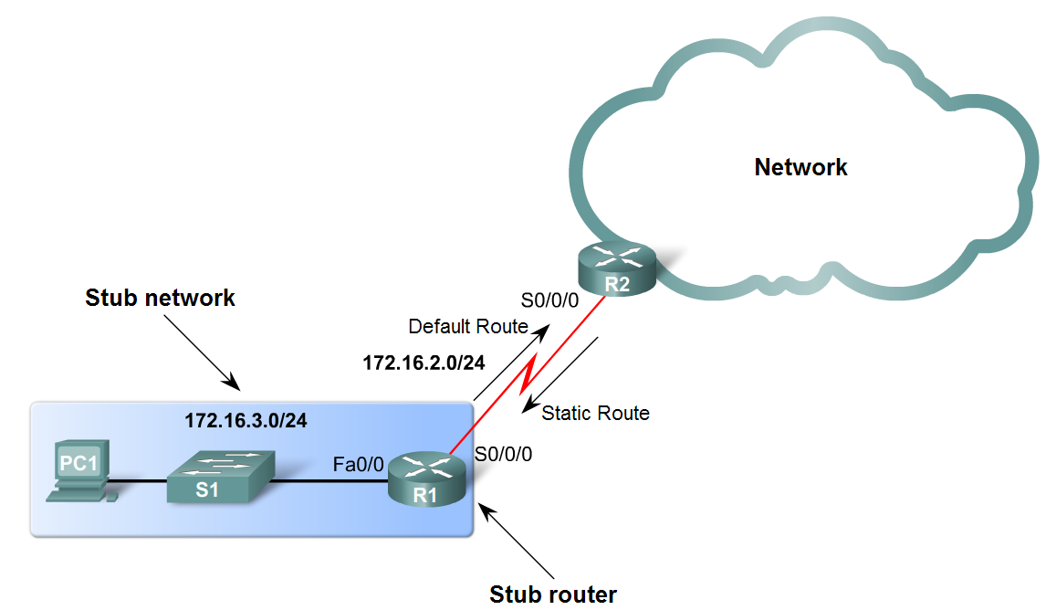
Static Routes with Exit Interfaces
Purpose of a static route
  A manually configured route used when routing from a network to a stub network

Slide 11
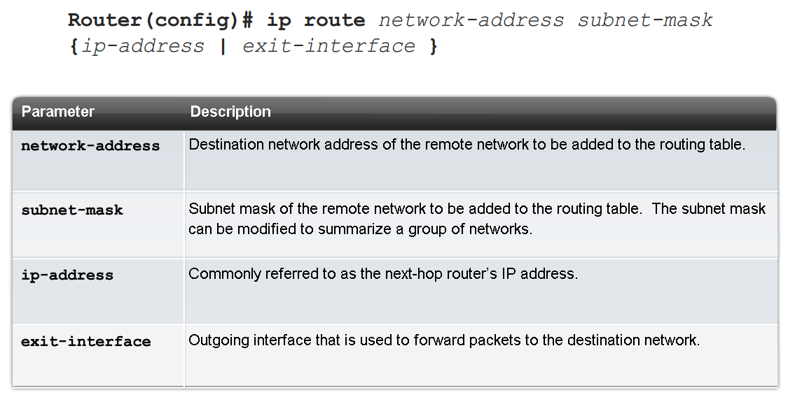
Static Routes with Exit Interfaces
IP route command
  To configure a static route use the following command: ip route
  Example:
    -Router(config)# ip route network-address subnet-mask {ip-address | exit-interface }

Slide 12

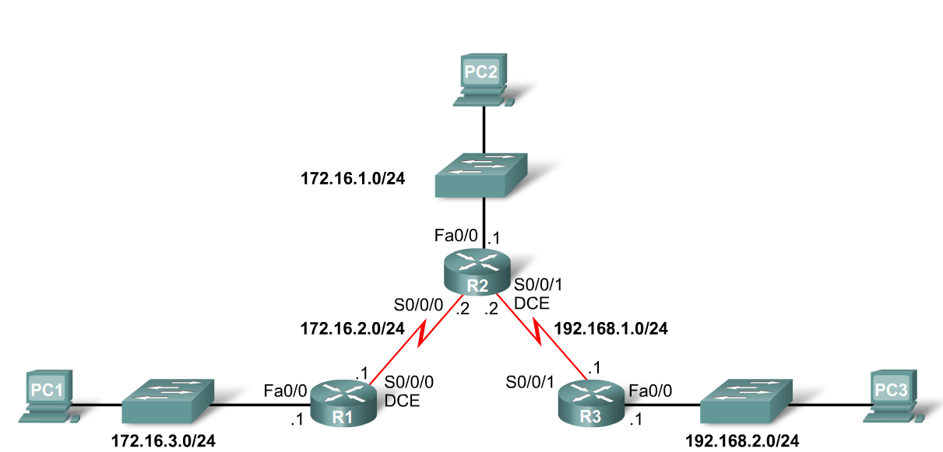
Static Routes with Exit Interfaces
Dissecting static route syntax
  ip route - Static route command
  172.16.1.0 – Destination network address
  255.255.255.0 - Subnet mask of destination network
  172.16.2.2 - Serial 0/0/0 interface IP address on R2, which is the "next-hop" to this network

Slide 13
Static Routes with Exit Interfaces
Configuring routes to 2 or more remote networks
  Use the following commands for R1
    -R1(config)#ip route 192.168.1.0 255.255.255.0 172.16.2.2
    -R1(config)#ip route 192.168.2.0 255.255.255.0 172.16.2.2

Slide 14
Static Routes with Exit Interfaces
Zinin’s 3 routing principles
  Principle 1: "Every router makes its decision alone, based on the information it has in its own routing table.“
  Principle 2: "The fact that one router has certain information in its routing table does not mean that other routers have the same information.“
  Principle 3: "Routing information about a path from one network to another does not provide routing information about the reverse, or return path."

Slide 15
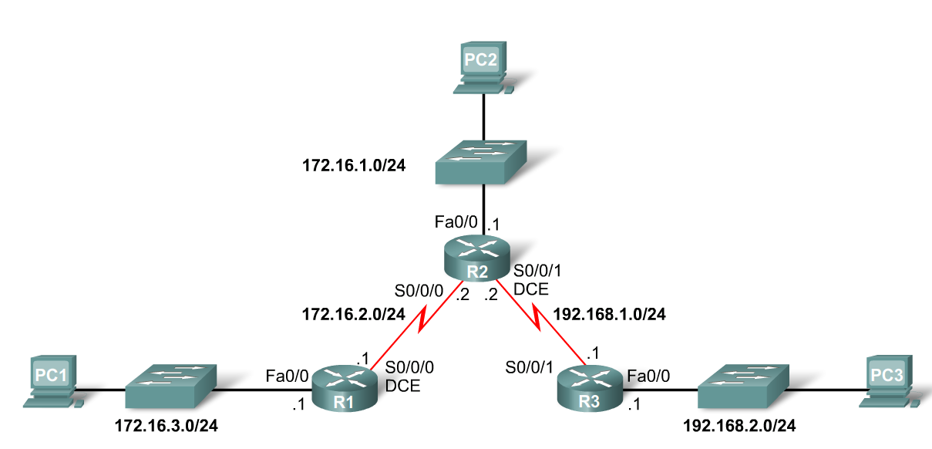
Static Routes with Exit Interfaces
Using Zinin’s 3 routing principles, how would you answer the following?
  -Would packets from PC1 reach their destination?
    Yes, packets destined for 172.16.1.0/24 and 192.168.1.0/24 networks would reach their destination.
  -Does this mean that any packets from these networks destined for 172.16.3.0/24 network will reach their destination?
    No, because neither R2 nor R3 router has a route to the 172.16.3.0/24 network.

Slide 16
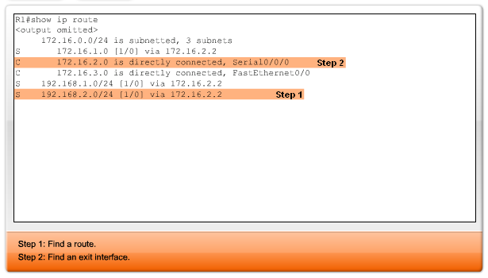
Static Routes with Exit Interfaces
Resolving to an Exit Interface
  -Recursive route lookup - Occurs when the router has to perform multiple lookups in the routing table before forwarding a packet. A static route that forwards all packets to the next-hop IP address goes through the following process (reclusive route lookup)
    The router first must match static route’s destination IP address with the Next hop address
    The next hop address is then matched to an exit interface

Slide 17
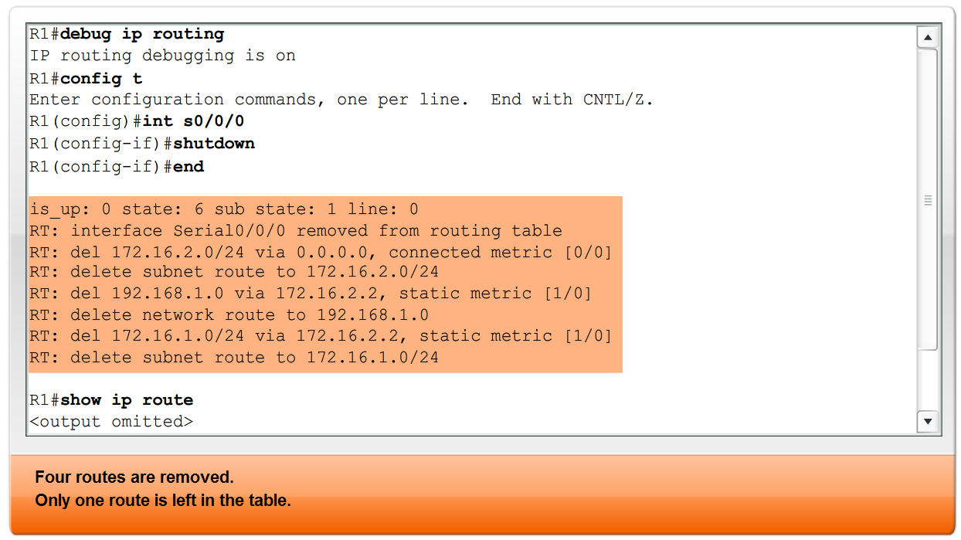
Static Routes with Exit Interfaces
Configuring a Static route with an Exit Interface
  -Static routes configured with an exit interface are more efficient because the routing
  The routing table can resolve the exit interface in a single search instead of 2 searches
  -Example of syntax require to configure a static route with an exit interface

Slide 18
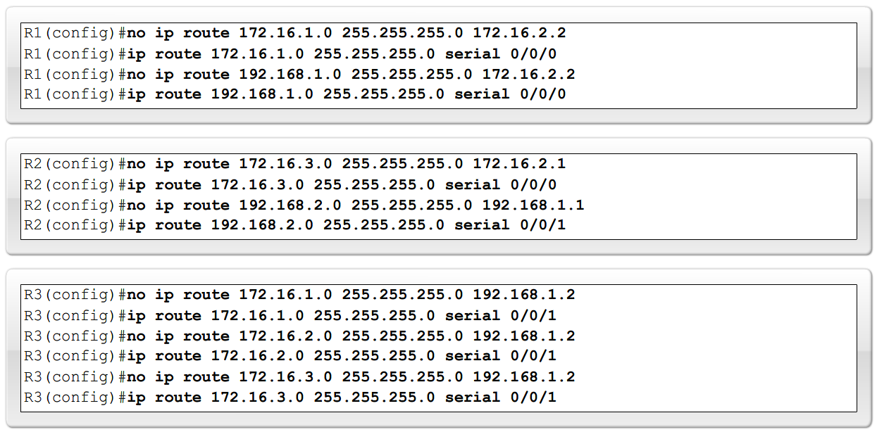
Static Routes with Exit Interfaces
Modifying Static routes
  Existing static routes cannot be modified. The old static route must be deleted by placing no in front of the ip route
  Example:
    -no ip route 192.168.2.0 255.255.255.0 172.16.2.2
  A new static route must be rewritten in the configuration

Slide 19
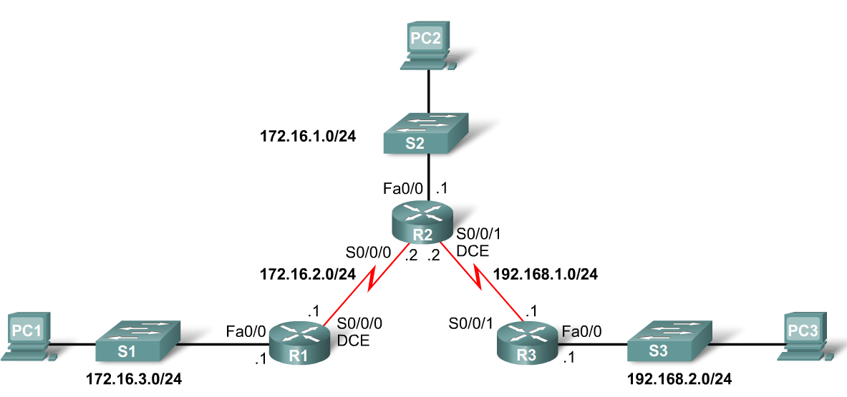
Static Routes with Exit Interfaces
Verifying the Static Route Configuration
  -Use the following commands
    Step 1 show running-config
    Step 2 verify static route has been entered correctly
    Step 3 show ip route
    Step 4 verify route was configured in routing table
    Step 5 issue ping command to verify packets can reach destination and that Return path is working

Slide 20
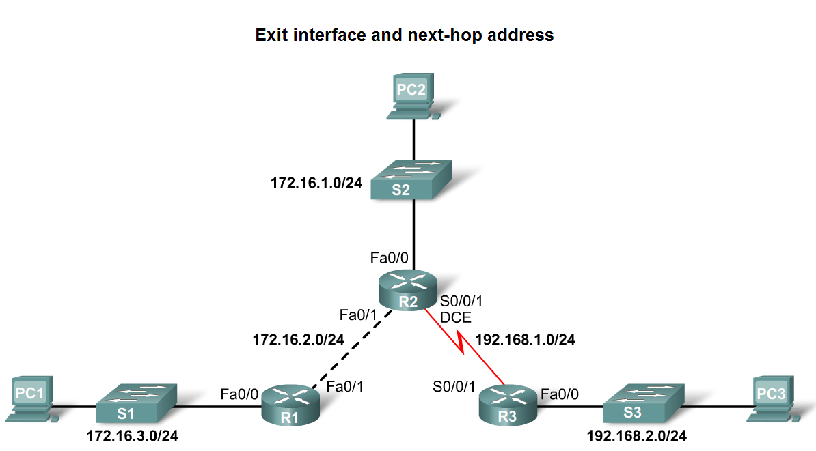
Static Routes with Exit Interfaces
Ethernet interfaces and ARP.
  If a static route is configured on an Ethernet link
  -If the packet is sent to the next-hop router then…
  the destination MAC address will be the address of the next hop’s Ethernet interface
  This is found by the router consulting the ARP table.
  If an entry isn’t found then an ARP request will be sent out

Slide 21
Summary and Default Route
Summarizing routes reduces the size of the routing table.
Route summarization is the process of combining a number of static routes into a single static route.
Notes:
Use graphic 2.6.1.1.

Slide 22
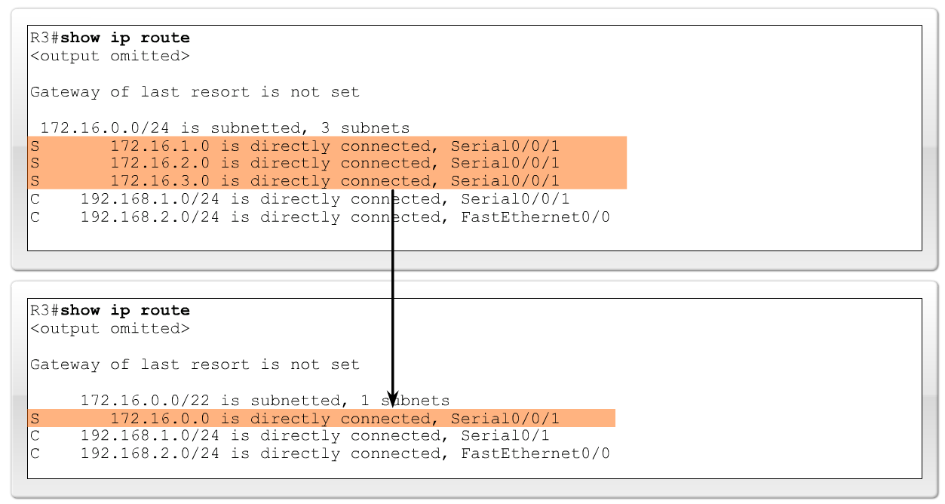
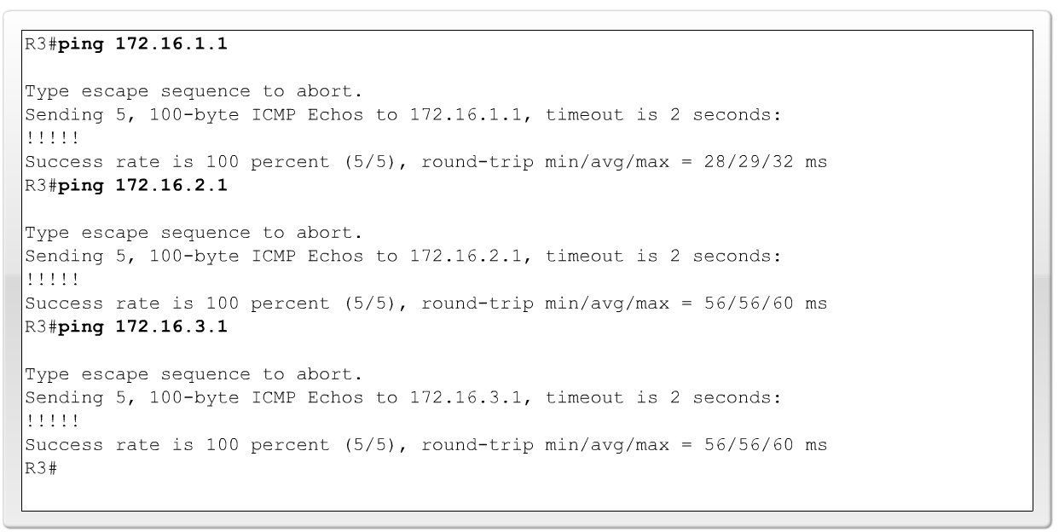
Summary and Default Route
Configuring a summary route
  Step 1: Delete the current static route
  Step 2: Configure the summary static route
  Step 3: Verify the new static route

Slide 23
Summary and Default Route
Default Static Route
  This is a route that will match all packets. Stub routers that have a number of static routes all exiting the same interface are good candidates for a default route.
    -Like route summarization this will help reduce the size of the routing table
Configuring a default static route
  Similar to configuring a static route. Except that destination IP address and subnet mask are all zeros
  Example:
    -Router(config)#ip route 0.0.0.0 0.0.0.0 [exit-interface | ip-address ]

Slide 24
Summary and Default Route
Static routes and subnet masks
  The routing table lookup process will use the most specific match when comparing destination IP address and subnet mask
Default static routes and subnet masks
  Since the subnet mask used on a default static route is 0.0.0.0 all packets will match.
Notes:
Use graphic 2.6.2.2

Slide 25
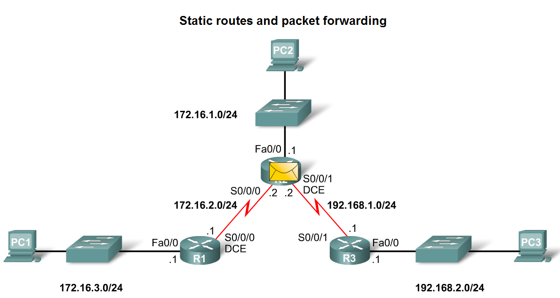
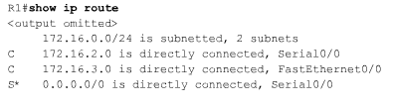
Static Routes and Packet Forwarding
Packet forwarding with static routes. (recall Zinin’s 3 routing principles)
Router 1
  Packet arrives on R1’s Fastethernet 0/0 interface
  R1 does not have a route to the destination network, 192.168.2.0/24
  R1 uses the default
  static route.

Slide 26
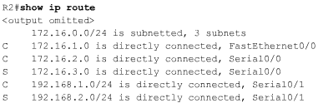

Static Routes and Packet Forwarding
Router 2
  The packet arrives on the Serial 0/0/0 interface on R2.
  R2 has a static route to 192.168.2.0/24 out Serial0/0/1.

Slide 27
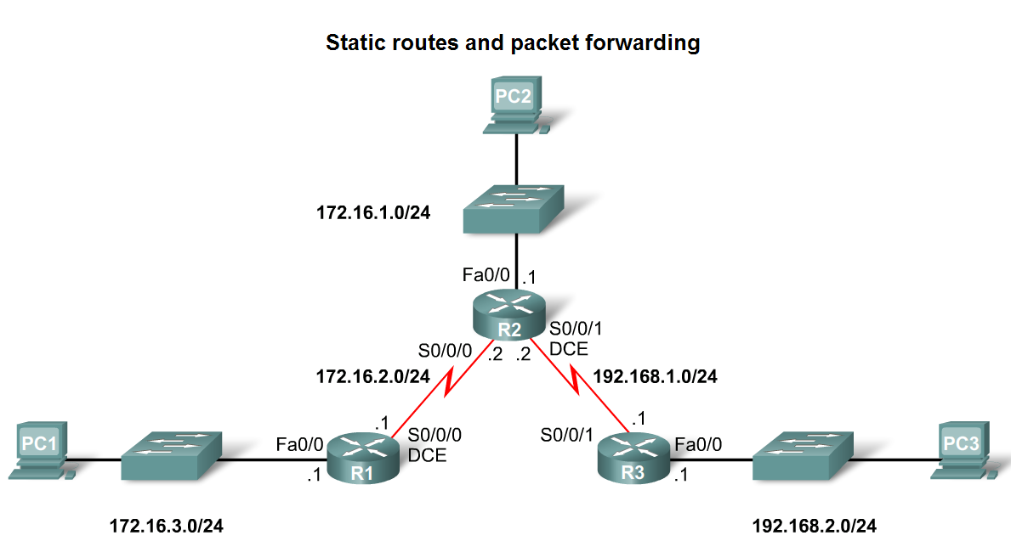
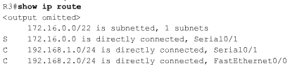
Static Routes and Packet Forwarding
Router 3
  The packet arrives on the Serial0/0/1 interface on R3.
  R3 has a connected route to 192.168.2.0/24 out Fastethernet 0/1.

Slide 28
Static Routes and Packet Forwarding
Troubleshooting a Missing Route
Tools that can be used to isolate routing problems include:
  -Ping– tests end to end connectivity
  -Traceroute– used to discover all of the hops (routers) along the path between 2 points
  -Show IP route– used to display routing table & ascertain forwarding process
  -Show ip interface brief- used to show status of router interfaces
  -Show cdp neighbors detail– used to gather configuration information about directly connected neighbors

Slide 29
Static Routes and Packet Forwarding
Solving a Missing Route
Finding a missing or mis-configured route requires methodically using the correct tools
  -Start with PING. If ping fails then use traceroute to determine where packets are failing to arrive
Issue: show ip route to examine routing table.
  -If there is a problem with a mis-configured static route remove the static route then reconfigure the new static route

